Slide 1
FILE MANAGEMENT
FILES AND FILESYSTEMS

Slide 2
FILES AND FILESYSTEMS
File Management
Files and file systems
A file management or file system is that set of system software that provides services to users and applications in the use of files.
The file system provides the resource abstractions typically associated with secondary storage. The file system permits users to create data collections, called files, with desirable properties, such as
• Long-term existence: Files are stored on disk or other secondary storage and do not disappear when a user logs off.
• Sharable between processes: Files have names and can have associated access permissions that permit controlled sharing.
• Structure: Depending on the file system, a file can have an internal structure that is convenient for particular applications. In addition, files can be organized into hierarchical or more complex structure to reflect the relationships among files.

Slide 3
FILES AND FILESYSTEMS
Any file system provides not only a means to store data organized as files, but a collection of functions that can be performed on files. Typical operations include the following:
Create: A new file is defined and positioned within the structure of files.
Delete: A file is removed from the file structure and destroyed.
Open: An existing file is declared to be “opened” by a process, allowing the process to perform functions on the file.
Close: The file is closed with respect to a process, so that the process no longer may perform functions on the file, until the process opens the file again.

Slide 4
FILES AND FILESYSTEMS
File operations cont’d
Read: A process reads all or a portion of the data in a file.
• Write: A process updates a file, either by adding new data that expands the size of the file or by changing the values of existing data items in the file.
Typically, a file system maintains a set of attributes associated with the file.
These include owner, creation time, time last modified, access privileges, and so on.

Slide 5
FILES AND FILESYSTEMS
File Structure
Four terms are in common use when discussing files:
Field
Record
File
Database
A field is the basic element of data. An individual field contains a single value, such as an employee’s last name, a date, or the value of a sensor reading. It is characterized by its length and data type (e.g., ASCII string, decimal). Depending on the file design, fields may be fixed length or variable length.

Slide 6
FILES AND FILESYSTEMS
A record is a collection of related fields that can be treated as a unit by some application program. For example, an employee record would contain such fields as name, social security number, job classification, date of hire, and so on. Again, depending on design, records may be of fixed length or variable length.
A file is a collection of similar records. The file is treated as a single entity by users and applications and may be referenced by name. Files have file names and may be created and deleted. Access control restrictions usually apply at the file level. In a shared system, users and programs are granted or denied access to entire files.
A database is a collection of related data. The essential aspects of a database are that the relationships that exist among elements of data are explicit and that the database is designed for use by a number of different applications. A database may contain all of the information related to an organization or project, such as a business or a scientific study.

Slide 7
FILES AND FILESYSTEMS
Objectives for a file management system:
To meet the data management needs and requirements of the user, which include storage of data and the ability to perform other file operations?
o guarantee, to the extent possible, that the data in the file are valid
To optimize performance, both from the system point of view in terms of overall throughput and from the user’s point of view in terms of response time
To provide I/O support for a variety of storage device types
o minimize or eliminate the potential for lost or destroyed data
To provide a standardized set of I/O interface routines to user processes
• To provide I/O support for multiple users, in the case of multiple-user systems

Slide 8
FILES AND FILESYSTEMS
File directories
Associated with any file management system and collection of files is a file directory.
The directory contains information about the files, including attributes, location, and ownership.
Much of this information especially that concerned with storage is managed by the operating system.
The directory is itself a file, accessible by various file management routines.

Slide 9
FILES AND FILESYSTEMS
Directory Structure
The simplest form of structure for a directory is that of a list of entries, one for each file.
This structure could be represented by a simple sequential file, with the name of the file serving as the key.
To understand the requirements for a file structure, it is helpful to consider the types of operations that may be performed on the directory:
• Search: When a user or application references a file, the directory must be searched to find the entry corresponding to that file.
• Create file: When a new file is created, an entry must be added to the directory.

Slide 10
FILES AND FILESYSTEMS
Delete file: When a file is deleted, an entry must be removed from the directory.
List directory: All or a portion of the directory may be requested. Generally, this request is made by a user and results in a listing of all files owned by that user, plus some of the attributes of each file (e.g., type, access control information, usage information).
Update directory: Because some file attributes are stored in the directory, a change in one of these attributes requires a change in the corresponding directory entry.

Slide 11
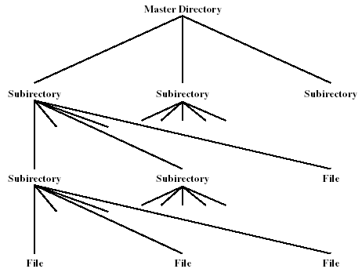
FILES AND FILESYSTEMS
Tree-Structured directory

Slide 12
FILES AND FILESYSTEMS
Directory structure; To organize files, many systems provide a hierarchical file system arrangement. It can have files, and then directories of files. Common arrangement: tree of files. Naming can be absolute, relative, or both.
A more powerful and flexible approach, and one that is almost universally adopted, is the hierarchical, or tree-structure, approach.
In tree structure approach, there is a master directory, which has under it a number of user directories.
Each of these user directories, in turn, may have subdirectories and files as entries. This is true at any level: That is, at any level, a directory may consist of entries for subdirectories and/or entries for files.

Slide 13
FILES AND FILESYSTEMS
Naming
Users need to be able to refer to a file by a symbolic name. Clearly, each file in the system must have a unique name in order that file references be unambiguous.
On the other hand, it is an unacceptable burden on users to require that they provide unique names, especially in a shared system.
The use of a tree-structured directory minimizes the difficulty in assigning unique names.
Any file in the system can be located by following a path from the root or master directory down various branches until the file is reached.
The series of directory names, ending with the file name itself, constitutes a pathname for the file.

Slide 14
FILES AND FILESYSTEMS
As an example, a file can have the pathname UserB\Word\UnitA\ABC. The slash is used to delimit names in the sequence.
The name of the master directory is implicit, because all paths start at that directory.
Note that it is perfectly acceptable to have several files with the same file name, as long as they have unique pathnames, which is equivalent to saying that the same file name may be used in different directories.
Typically, an interactive user or a process has associated with it a current directory, often referred to as the working directory. Files are then referenced relative to the working directory.

Slide 15
FILES AND FILESYSTEMS
Directory table
This is a list of subdirectories and files. When a physical drive is first installed, it can be divided into one or more logical drives such as drive C and drive D. These logical drives are sometimes called volumes.
Root directory
When each logical drive is formatted, a single directory table is placed on the drive called the root directory.
For a logical drive such as C the root directory is written as C:\. This root directory can hold files or other directories, which can have names such as C:\Tools.
These directories are called subdirectories, child directories, or folders.

Slide 16
FILES AND FILESYSTEMS
File integrity
File-system integrity refers to whether the file-system contains errors. Sometimes this is caused by a user turning off the computer system without first shutting the computer down properly.
File confidentiality
Security measures to protect files from unauthorized access, malicious destruction or alteration and accidental introduction of inconsistency.

Slide 17
FILES AND FILESYSTEMS
File sharing
In a multiuser system, there is almost always a requirement for allowing files to be shared among a number of users. Two issues arise: access rights and the management of simultaneous access.
Access Rights
The file system should provide a flexible tool for allowing extensive file sharing among users.
The file system should provide a number of options so that the way in which a particular file is accessed can be controlled.
Typically, users or groups of users are granted certain access rights to a file. A wide range of access rights has been used.

Slide 18
FILES AND FILESYSTEMS
The following list is representative of access rights that can be assigned to a particular user for a particular file:
None: The user may not even learn of the existence of the file, much less access it. To enforce this restriction, the user would not be allowed to read the user directory that includes this file.
Knowledge: The user can determine that the file exists and who its owner is. The user is then able to petition the owner for additional access rights.
Execution: The user can load and execute a program but cannot copy it. Proprietary programs are often made accessible with this restriction.

Slide 19
FILES AND FILESYSTEMS
Reading: The user can read the file for any purpose, including copying and execution. Some systems are able to enforce a distinction between viewing and copying. In the former case, the contents of the file can be displayed to the user, but the user has no means for making a copy.
Appending: The user can add data to the file, often only at the end, but cannot modify or delete any of the file’s contents. This right is useful in collecting data from a number of sources.
Updating: The user can modify, delete, and add to the file’s data. This normally includes writing the file initially, rewriting it completely or in part, and removing all or a portion of the data. Some systems distinguish among different degrees of updating.
Changing protection: The user can change the access rights granted to other users. Typically, this right is held only by the owner of the file. In some systems, the owner can extend this right to others. To prevent abuse of this mechanism, the file owner will typically be able to specify which rights can be changed by the holder of this right.
Deletion: The user can delete the file from the file system.

Slide 20
FILES AND FILESYSTEMS
These rights can be considered to constitute a hierarchy, with each right implying those that precede it. Thus, if a particular user is granted the updating right for a particular file, then that user is also granted the following rights: knowledge, execution, reading, and appending.
One user is designated as owner of a given file, usually the person who initially created a file. The owner has all of the access rights listed previously and may grant rights to others. Access can be provided to different classes of users:
Specific user: Individual users who are designated by user ID.
User groups: A set of users who are not individually defined. The system must have some way of keeping track of the membership of user groups.
All: All users who have access to this system. These are public files.

Slide 21
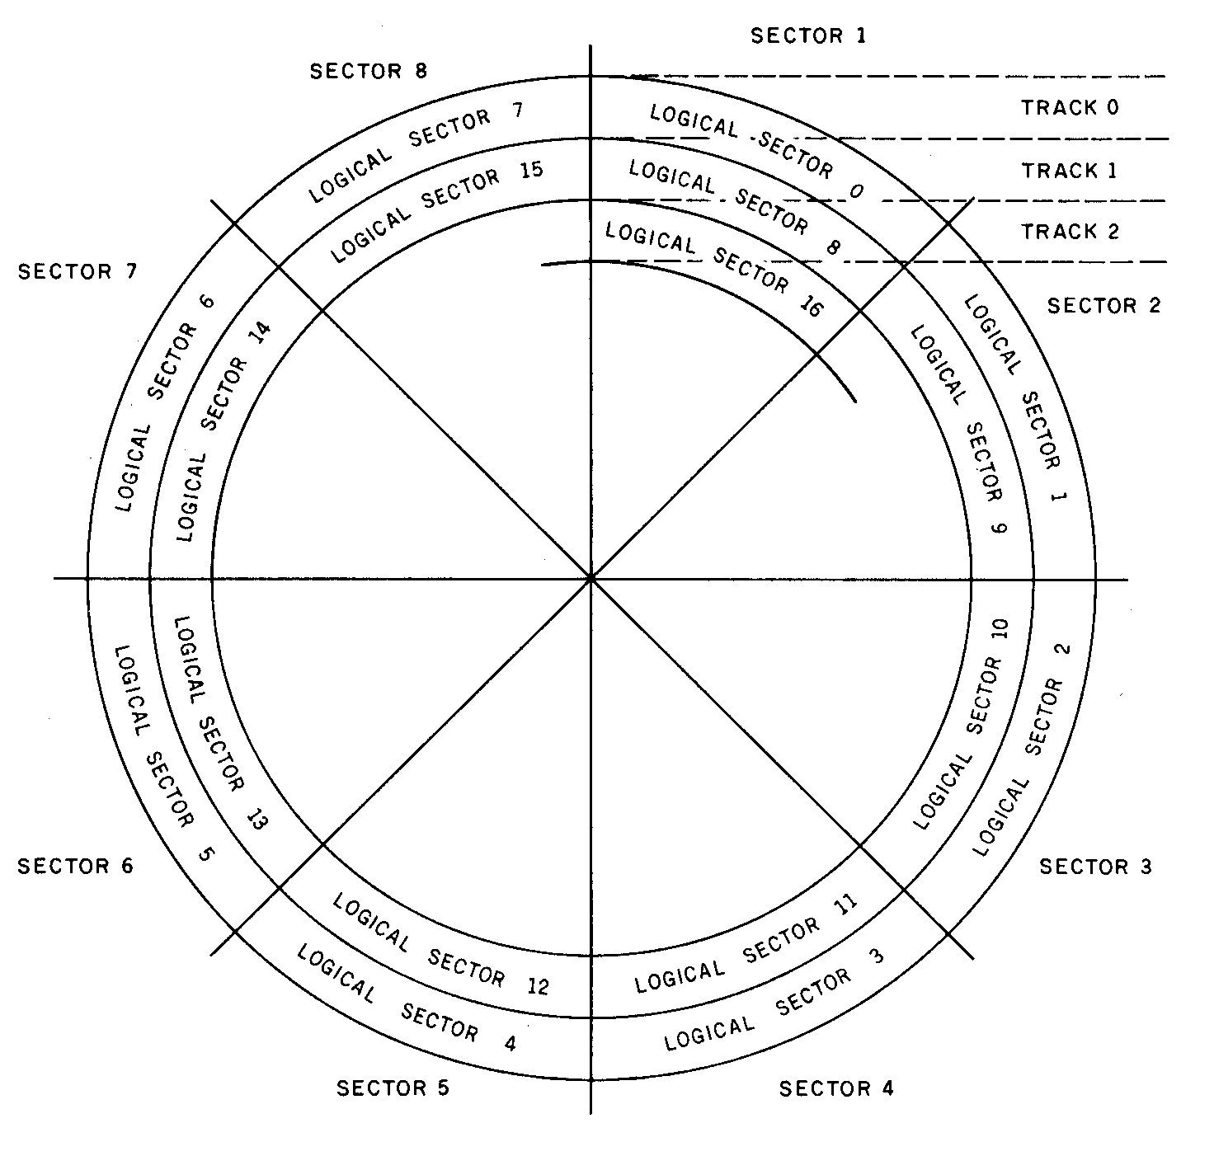
File Structure

Slide 22
File Structure
Disks are always divided up into tracks and sectors, as shown in the figure above
To access any particular block of data, the program first moves to the correct track, then has you wait while the spinning disk moves the correct sector under the head.
A somewhat more abstract view of disks was taken in developing MS-DOS. MS-DOS views the disk, not in terms of tracks and sectors, but as a continuous array of n logical sectors, numbered from 0 to n - 1.
The figure shows the usual method of numbering the logical sectors. Logical sector 0 is the first sector of the outermost track; the rest of the track (and the next, etc.) is numbered sequentially. Logical sector n - 1 is the last sector on the innermost track.

Slide 23
WINDOWS FILE SYSTEMS
The Windows operating system supports the following file systems.
FAT- File Allocation Table
The MS-DOS operating system introduced the File Allocation Table system of keeping track of file entries and free clusters.
Filenames where restricted to eight characters with an addition three characters signifying the file type.
FAT32
An updated version of the FAT system designed for Windows 98.
It supports file compression and long filenames.
NTFS- New Technology File System
Windows NT introduced the NT File System, designed to be more efficient at handling files than the FAT system.
It spreads file tables throughout the disk, beginning at the center of the storage space.
It supports file compression and long filenames.

Slide 24
FEATURES OF NTFS
Recoverability- NTFS has high reliability and is able to reconstruct disk volumes and return them to a consistent state. NTFS uses transaction logging to log all folders and file updates automatically.
Security- NTFS uses the windows object model to enforce security. An open file is implemented as a file object with a security descriptor that defines its attributes. The attribute contains the access token of the owner of the file, and an access control list that states the access privileges that are granted to each user that has access to the fiile.
Support for large disks and large files- NTFS supports very large disks and very large files more efficiently than other file systems including FAT.
Support for cluster remapping- If a failure occurs because of a faulty sector on the hard disk, NTFS allocates a new cluster to replace the cluster with the faulty sector. NTFS then stores the address of the cluster containing the faulty sector so that the faulty sector is not reused.

Slide 25
FEATURES OF NTFS
General indexing facility- NTFS associates a collection of attributes with each file. The set of file descriptions in the file management system is organized as a relational database, so that files can be indexed by any attribute.
Reduces file fragmentation- NTFS reduces file fragmentation by attempting to write files contiguously on the partition. A file can become fragmented as it grows in size, depending on the disk’s space usage.
Supports Disk quotas- An administrator is able to assign portions of disk space to a variety of users based on their demands

Slide 26
Windows 7 installation
Check the following minimum requirements:
Hard disk capacity
RAM capacity
Processor speed
CD drive (if booting from cd)
I/O devices (mouse and keyboard)
Screen resolution.
State the minimum requirement specifications for windows 7 and windows XP OS installation.

Slide 27
Windows 7 installation
Plan the installation
Installation options
-Clean install (fresh copy)
-Upgrade (Picks previous installed software
Partitioning of drive and filesystem (NTFS for Windows 7)
Networking options- Domain or workgroup
Installation media- CD or network
Boot order-order of drives to choose boot media
Ensure you have backed up important files

Slide 28
Windows 7 installation
Procedures for optimizing Windows 7 environment
Put in place to back up windows system files after you have made changes
Set W7 so that it automatically downloads updates
Use firewalls and anti-virus software to protect the system from attacks
Create user accounts so that users can do their jobs and perform routine maintenance, but cannot make major changes to the system that have not been authorized
Put procedures in place to keep current backups of user data
Teach users how to routinely clean up hard drive and how to verify that their data backups are current and data recovery routines work
Check that unneeded software and services are not clogging up the system and that memory settings are optimized

Slide 29
BOOT-UP PROCESS
Boot-up process or Booting process is the process of switching on the computer and loading the operating system
Cold boot- initial boot-up from a cold state
Warm boot- System restart from a hot state

Slide 30
BOO-UP PROCESS
Booting process of Windows 7
When the computer's power is first turned on, the CPU initializes itself, which is triggered by a series of clock ticks generated by the system clock.
It looks to the system's ROM BIOS for its first instruction in the startup program.
The ROM BIOS stores the first instruction, which is the instruction to run the power-on self test (POST), in a predetermined memory address.
POST checks the inventoried hardware to ensure they are functioning properly.

Slide 31
BOO-UP PROCESS
Once the POST has determined that all components are functioning properly and the CPU has successfully initialized the BIOS looks for an OS to load.
The BIOS typically looks to the CMOS chip to tell it where to find the OS, and in most PCs, the OS loads from the C drive on the hard drive. The order of drives that the CMOS looks to in order to locate the OS is called the boot sequence.
The BIOS will first encounter the boot record, which tells it where to find the beginning of the OS and the subsequent program file that will initialize the OS.
Once the OS initializes, the BIOS copies its files into memory and the OS basically takes over control of the boot process.

Slide 32
BOOT-UP PROCESS
Cont’d booting process
Now in control, the OS performs another inventory of the system's memory and memory availability and loads the device drivers that it needs to control the peripheral devices
The user is the presented with the log on screen, after which the user can access the system’s applications to perform tasks.

